Slide 1
Usage of “Base Adapter” and “ViewHolder”

Slide 2
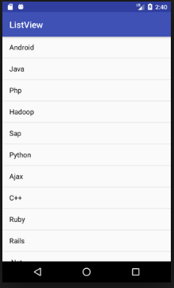
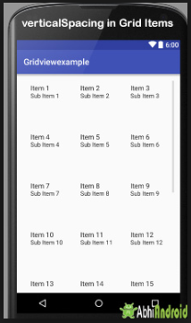
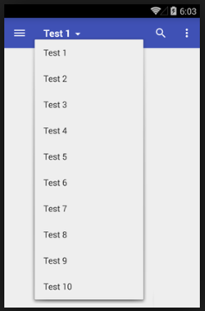
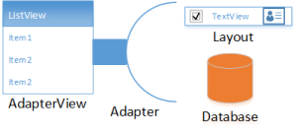
Base Adapter
Adapter → bridge between UI and data source.
It pulls data from database or and array.
After pulling data from database, it sends data to adapter view, then adapter view send it to view.
Final stage view shows data on different views like ListView, GridView, Spinner, RecyclerView, etc.
An adapter provide simple view → Base Adapter.
Notes:
https://1.bp.blogspot.com/-98J07YPlnWc/V6VTXRPRvJI/AAAAAAAAEVA/HwVLJohteyII5ibLlc61n6nogs2nepLwgCLcB/s1600/List%2BRecyclerView%2BAndroid.gif

Slide 3
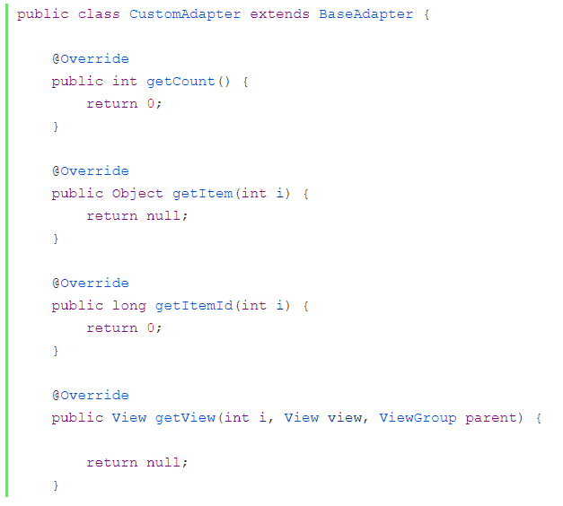
Base Adapter Mind Frame!
getCount() → used to returns total number of items which are going to display in list.
getItem() → used to get the data items associated with the specified position in the data set.
getItemId() → returns the corresponding to the position item id.
getView() → called when items are going to display in ListView of GridView or Spinner

Slide 4
View Holder
The ViewHolder pattern is a pattern that a developer can use to increase the speed at which their ListView renders data.
ViewHolder is a pattern used to avoid calling “findViewById” every time the getView() method is called.
Imagine that you have a list with hundreds of rows, the “findViewById” will be called hundreds of times and it’s not necessary, just bad for performance.
So to increase the performance try to use the ViewHolder pattern as much as possible.
/**
* Used to avoid calling "findViewById" every time the getView() method is called,
* because this can impact to your application performance when your list is large
*/
private class ViewHolder {
protected TextView itemName;
}

